Slide 1
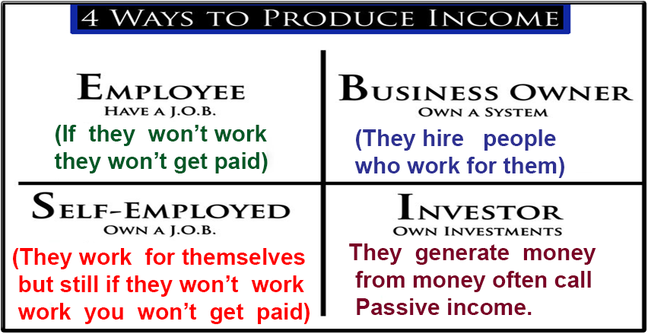
Cash flow Quadrant Explained

Slide 2
E - Employee
E quadrant belongs to employee who has a job. This is where most people earn their income. Employee can make little or lot of money, but when employee stops working, or when the business stops, their income stops too.
An Employee financial destiny, security and freedom is based upon the success of their employer.
Low Level – Middle Level – Top Level.

Slide 3
S – Self Employed
The S quadrant includes those people who prefer to work for themselves and prefer to be their own boss.
Include dentist, lawyers, restaurant owners, insurance agents, property agents, sales person etc..
Many self employed people generate large income and obviously they do have lot of control than an employee but when they stop working, their income also stops.
Means in the long run lead to tiredness and fatigue.

Slide 4
B – Business Owner
The B quadrant own a system and lead or supervise people, system automatically runs and owner of system or business earns money with out constant involvement.
Sometimes same type of business could be run by S owners and B owners.
Example:- If a person plead a case in court belongs to S quadrant and if he owns a law firm and junior counsel plead belong to B quadrant.

Slide 5
I – Investors
I quadrant belongs to people who own assets that produce income, investors in this quadrant have usually accumulated money earned from one or more of the other three quadrants.
Also called passive income. This obviously lead to greater growth in less hard work and obviously have more financial freedom.
Those people
Example:- share holders, business traders, property investors, social media influencer.

Slide 6
Best Quotes for Investment
Investing in yourself is the best investment you will ever make. It won’t only improve your life but also improve the life of your companions. (Robin Sharma)
Improve your hard skills, middle skills, soft skills.
If you have talent no one can take it or steal if or snatch it from you.(Warren Buffet).
The best investment is the invest in yourself, the more you learn more you earn. (Warren Buffet).
Your career is the engine of your wealth. (Warren Buffet).
Given a 10% chance of 100 times payoff , you should take that bet every time. (Jeff Bezos, Former President and CEO of Amazon)

Slide 7
summary

